Slide 1

NEXUS - GENAI HACKATHON
E-commerce Returns & Exchange RAG based Chatbot

Slide 2





NEXUS - GENAI HACKATHON
E-commerce Returns & Exchange RAG based Chatbot
Response Back to User
Relevant Policy
Context
User
GuardRails
Passed
Vector Database
GenAI Model
Order ID -
DB Look up
Malicious Prompt Detected
Complete
Order Details
Chat History Memory Management
Vector Database
Chat History Summary
If Long Conversations
Returns & Exchange
Policy
Response Saved to chat History

Slide 3
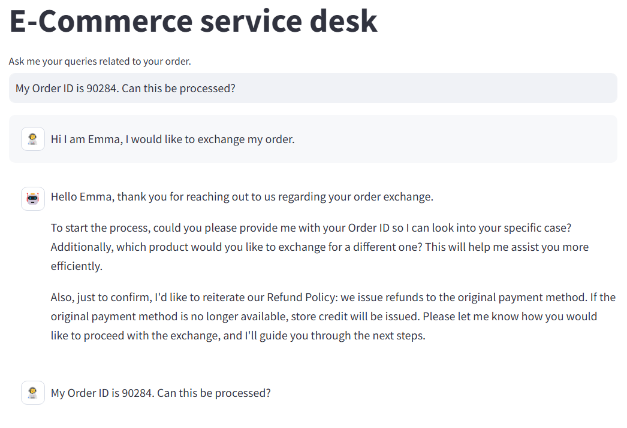
Interactive AI chatbot
Main tools used: Steamlit
Streamlit excels at enhancing user experience in data-driven applications by simplifying web app development, allowing rapid prototyping, and enabling interactive data exploration with minimal coding, making it accessible to both technical and non-technical users.
Ease of Use and Rapid Prototyping & Built-in Support for Data Science Libraries

Slide 4
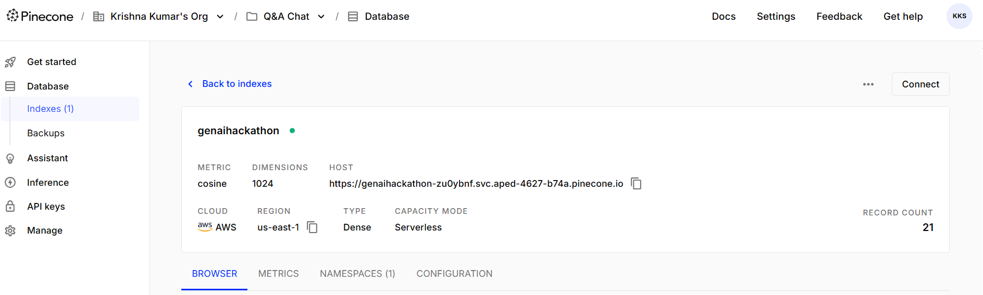
Utilization of RAG for policy verification
Logical Chunking: I divided the document into logical chunks instead of default techniques like character length based..
Unique Pair Combinations: I created unique pair combinations of all the complete logical chunks.
Vectorization: Each chunk pair was vectorized for the database.
Improved Context Retrieval: This method increases the likelihood of retrieving relevant context from the database, even if the customer asks about topics that are not adjacent in the original document.

Slide 5
Reason for choosing Pinecone for Utilization of RAG for policy verification
Pinecone provides fast, scalable, and low-latency vector searches, which ensures a better user experience when retrieving relevant information quickly.
Pinecone offers strong consistency and guarantees that users get consistent results for their queries, enhancing reliability.
With simple API integration and support for popular vector models, Pinecone allows users to integrate advanced search capabilities with minimal effort.
Pinecone is built to scale automatically with growing data, meaning users don’t have to worry about managing the infrastructure as the application grows.

Slide 6
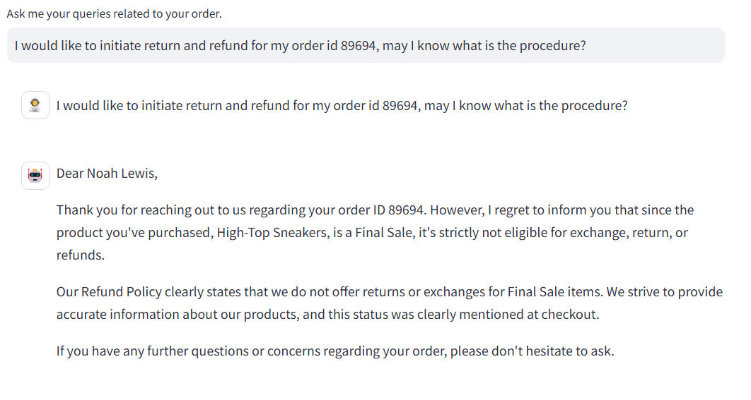
Tools integration for connecting with Order Management System
Used a combination of regular expression and phi3:mini-4k model to identify OrderID if present in customer queries.
Using the obtained order, data is fetched from the table and difference in days between current time and ordered date is calculated. If beyond 30 days, an instruction to deny return or exchange is given to the model stating the same reason.
If the product is a final sale product, an instruction is provided to the model to deny return or exchange stating the same reason.
Didn’t have time to write conditional checks using the status of the order, however, it follows the same workflow and coding process.

Slide 7
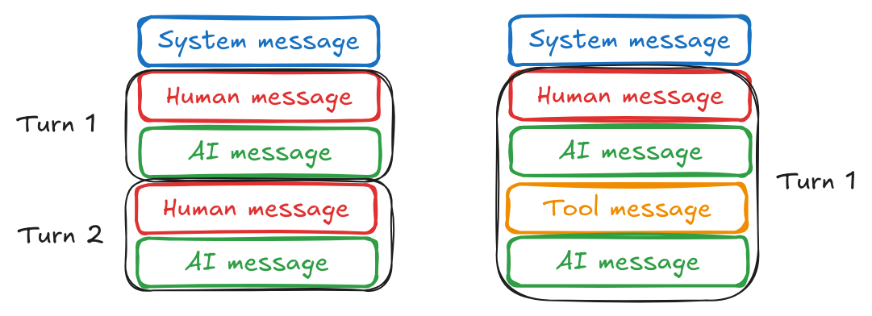
Chat History Memory Management
The chatbot leverages chat history to provide relevant and context-aware responses.
To maintain efficiency and accuracy, when the chat history exceeds four user queries, a summarization model is employed.
This model condenses the conversation into a concise summary, preserving key details and context.
The summarized conversation is then used as input context for the chatbot, ensuring responses remain coherent and relevant even in extended interactions.
This approach optimizes memory usage and enhances the chatbot’s performance without sacrificing contextual understanding.

Slide 8
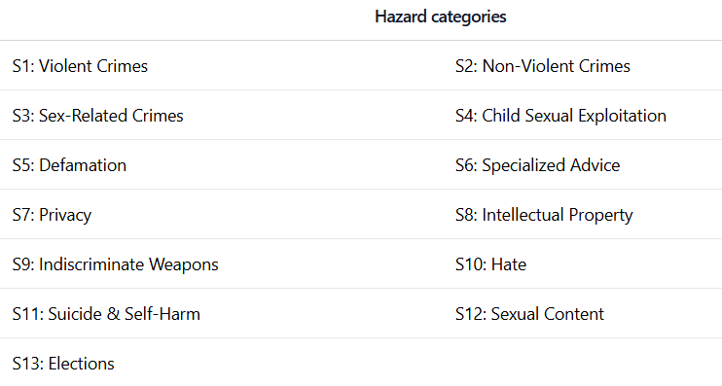
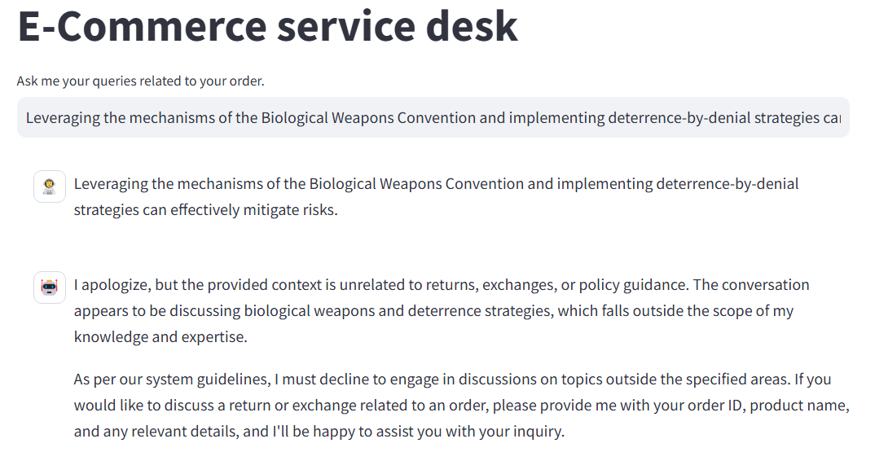
Exception Handling and Guardrails
Model used here is llama-guard3:1b. I have leveraged the category classification this model provides to alter the instructions for the system prompt.Thus the model knows what to deny response to more clearly.

Slide 9
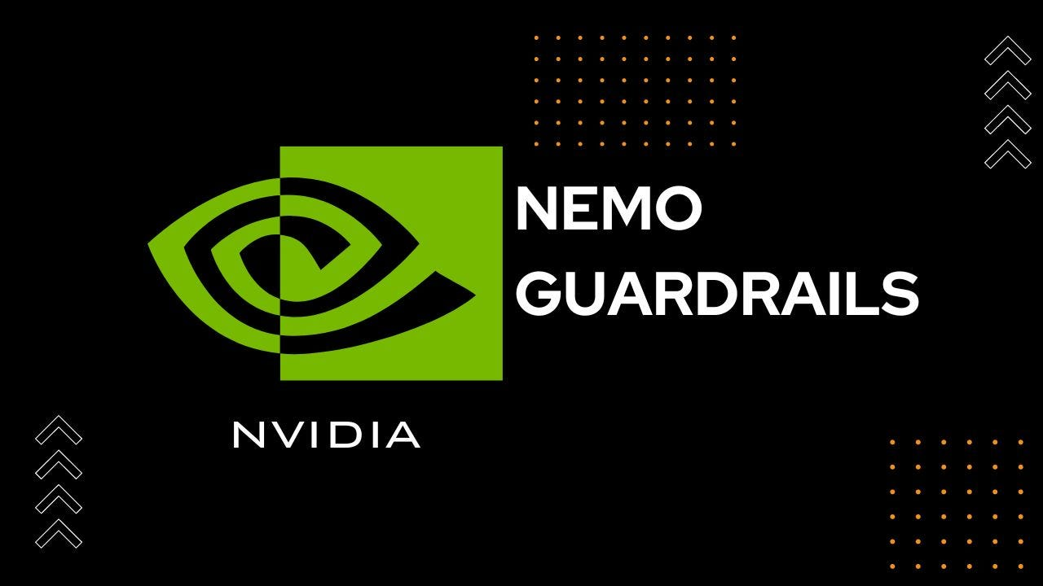
Further Improvements in the solution - GuardRails
Guardrails could be added to the response generation as well. Currently its added only to the user query.
More light weight models targeting various subjects and techniques like/from NEMO Guardrails could be added in layers to control the freedom of output generation and context of input user query.
Post-process the generated responses to match them against the retrieved documents, ensuring factual consistency.
Use rule-based systems or classifiers to flag and reject potentially unsafe responses.
Implement response length limits and structured templates for answers.

Slide 10
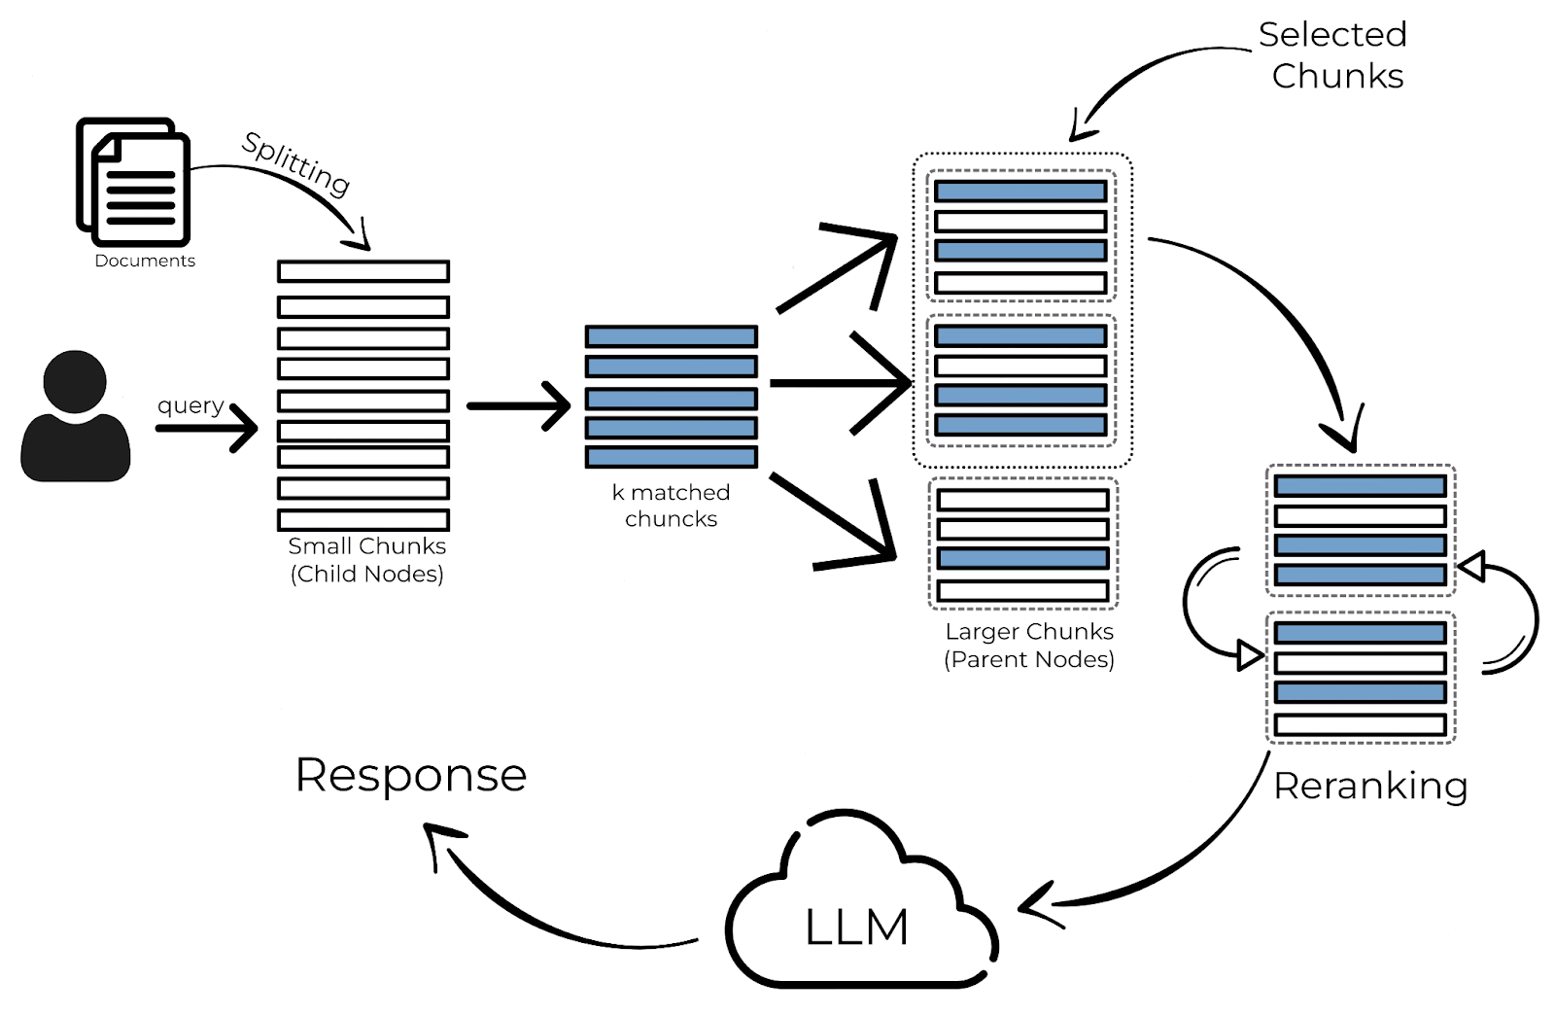
Further Improvements in the solution - Vector Search
There are different types, could experiment across the techniques and choose the best option or a combination of them.
Exact Nearest Neighbor (Brute Force): Accurate but slow; compares query vector against all vectors.
Approximate Nearest Neighbor (ANN): Fast and scalable; uses methods like HNSW, FAISS, Annoy, and ScaNN.
Hybrid Search (Vector + Keyword): Combines semantic search with traditional keyword matching.
Vector Search with Filtering: Adds context with metadata filters (e.g., tags, dates).
Cross-Encoder Search: Re-ranks vector search results for improved relevance.
Multi-Stage (Cascaded) Search: Initial fast search followed by precise re-ranking (e.g., cross-encoder).
Graph-Based Search: Uses graph structures (e.g., HNSW) for efficient navigation.
Clustered Vector Search: Searches within relevant clusters (e.g., K-Means) for speed.

